Slide 1
All About Data Science

Slide 2

Agenda
2019 Technology Trends
Quiz on DS
AI – Future and Current Situation
AI Applications
Data Generation in a minute around the World
Why is there a hype for Data Science?
What Harvard Say about DS
Domains Where AI is Used
India’s Analytics Industry – Key Facts
Data Scientist & its Aspects
Data Scientist Job Required Skills
Analytics
DS Life Cycle
Traditional Vs Machine Learning Programming
DS/AI/ML Contents
Languages & Machine Learning Programming
Machine learning Type/Packages
Linear Regression Example
Applications & Machine Learning Type
Word of Caution!
Q & A

Slide 3
2019 Technology Trends
DS/ML/AI
RPA
IOT
DevOps
Angular JS and ReactJS
Cloud computing – AWS, Azure, GCP
BigData
BlockChain

Slide 4
Quiz on DS
Which of these is not an analytics company?
Fractal
Mu Sigma
Google
JSW
Ans: JSW
2. Which is the AI smart speaker of Amazon?
Home
Echo
Cortana
Alexa
Ans: Alexa

Slide 5
Quiz on DS
3. Which company recently acquired the world famous visualisation software Tableau?
Facebook
Google
Microsoft
Salesforce
Ans: Salesforce
4. Which company has the largest market share in Cloud Computing?
Google cloud
Amazon Webservices
Microsoft Azure
IBM Cloud
Ans: Amazon Webservices

Slide 6
Quiz on DS
5. Which country declared Sofia as a citizen?
France
Qatar
Kuwait
Saudi Arabia
Ans: Saudi Arabia
6. Which is the most popular programming language for Data Science?
R
C
Java
Python
Ans:Python

Slide 7
Quiz on DS
7. Which of these companies have self-driving facility in their cars?
Tesla
Lamborghini
Bugatti
Koenigsegg
Ans:Tesla
8. Which is the first AI powered smartphone?
iPhone X
Google Pixel 2 XL
Huawei Mate 10
Samsung Galaxy S9
Ans:Huawei Mate 10

Slide 8
Quiz on DS
9. Which is the first movie written by an AI?
Lemon
The Rider
Sunspring
Step
Ans: Sunspring
10. Which is the first country to hire a minister for artificial intelligence?
China
USA
Japan
UAE
Ans: UAE

Slide 9
Quiz on DS
9. Which renowned company has revealed that it has close to 1400 job openings for a data scientist but not may skilled applicants?
Facebook
Google
Microsoft
WhatsApp
Ans: Facebook
10. Who is a new CEO of Alphabet company?
Sundar Pichai
Lary Page
Tim cook
Sergey Brin
Ans: Sundar Pichai

Slide 10
https://www.youtube.com/watch?v=fKVOtx7Blfk
Chatty Gargoyle at Denver International Airport
This is not reality but may happen in future for sure

Slide 11
https://www.youtube.com/watch?v=Ww8wX7kAtcI
Audi A7 Driverless Car Parking
This is reality

Slide 12
https://www.youtube.com/watch?v=gn4nRCC9TwQ
Google's DeepMind AI Just Taught Itself To Walk
This is reality

Slide 13
AI Applications
Amazon Purchase – Recommendation Engine
Netflix recommendation engine
Future dieases based on symptoms , Heart Attack detection
Diagnose the disease – Cancer, Tumour
OLA/UBER Pricing based on demand and supply/Peak hour
Loan Approval decision
Fake Currency identification
Credit Card Fraud Transaction
Driverless Car by Google, Tesla (Computer Vision)
Sentiment analysis using social media
Face Recognition – Facebook
Tagging a friend to other friends
Chatbots – Alexa, Siri, Google Assistant
Google Search autosuggestion
Gmail auto complete sentence feature
Predictive maintenance of a machine
Probability of delay in taking of a flight
Suggestion of a word typing WhatsApp
Convert image into speech to guide travellers
Weather forecasting
Determining discount and product pricing
Share Market
Insurance – Risk evaluation
Games – Chess, Cricket, all sports

Slide 14
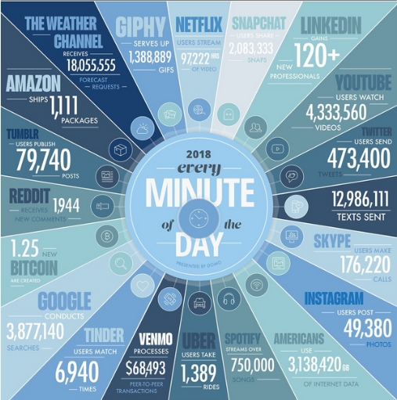
Data Generation in 1 Minute around the world

Slide 15
Why is there a hype for Data Science?
Huge amount of data generation
Computing Power
Algorithm developed
Type of Data
85% Unstructured Data : Social Media, Log files
Semi structured Data : JSON formatted data, NoSQL data
15% Structured Data : Table and Row format, CRM, RDBMS

Slide 16
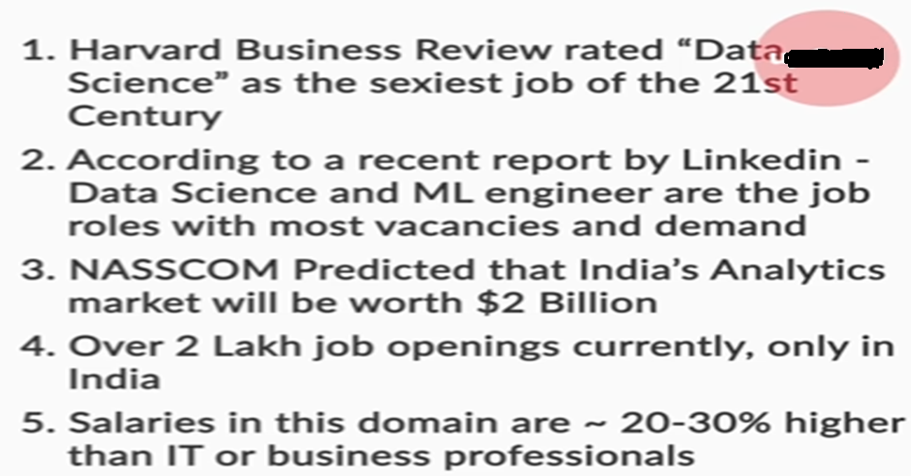
What Harvard Say about DS

Slide 17
Domains
Sports
Retail
Healthcare
Manufacturing
Transport
Banking
Airline
Finance
Pharmaceutical
Manufacturing
Automobile
Telecom
Advertisement
Education
Insurance
IT

Slide 18
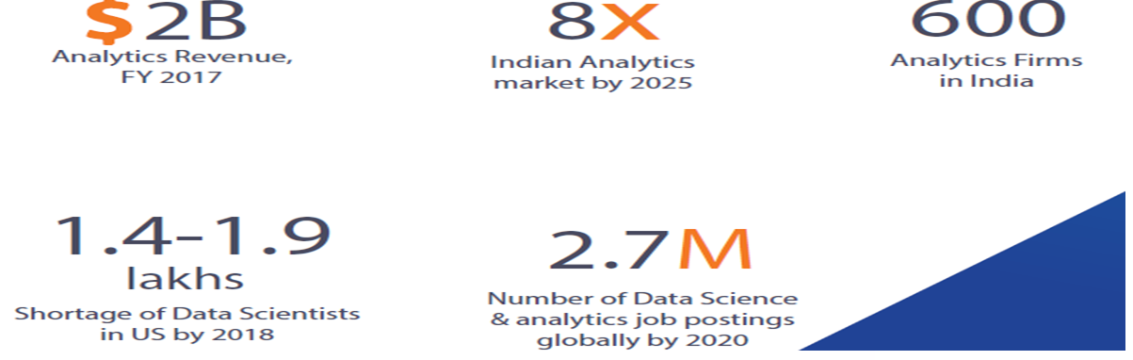
India’s Analytics Industry – Key Facts

Slide 19
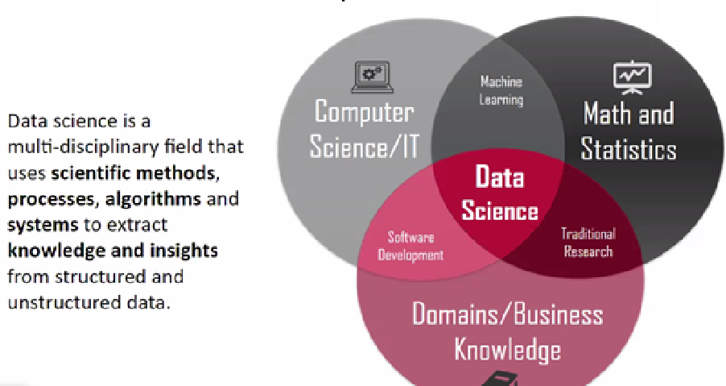
Data Scientist & its Aspects

Slide 20
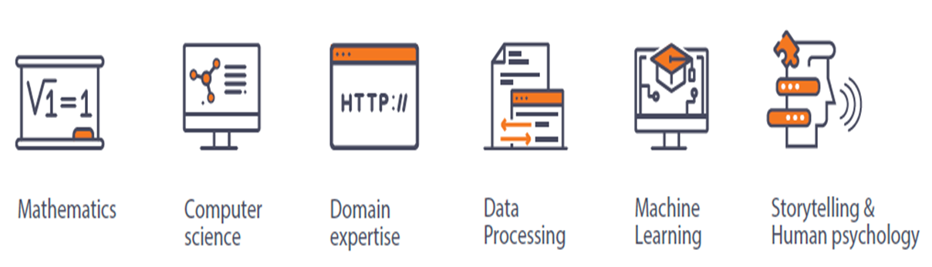
Data Scientist Job Required Skills

Slide 21
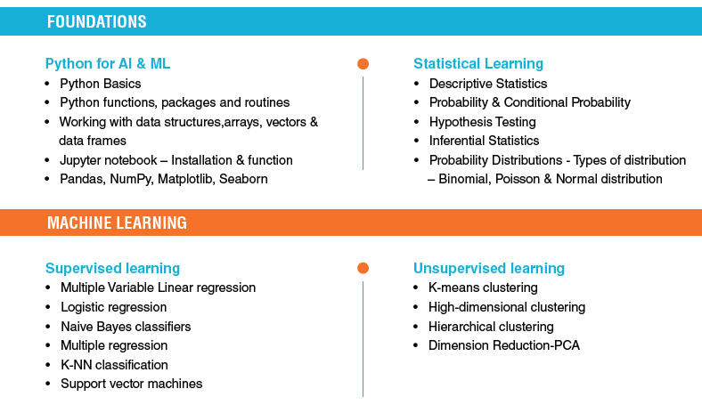

Slide 22
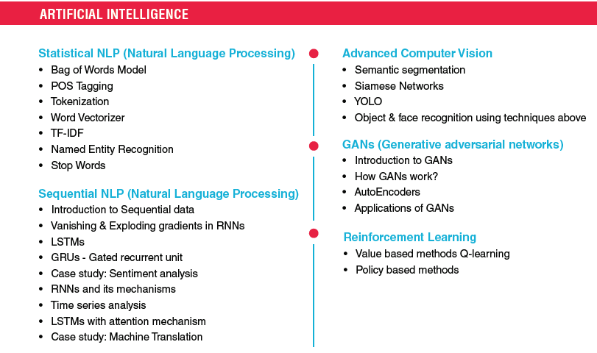

Slide 23
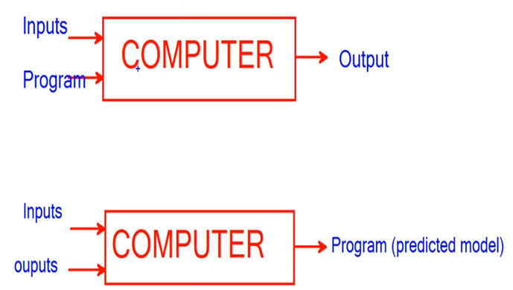
Traditional Vs Machine Learning Programming
Best example of ML is Kids Learning

Slide 24
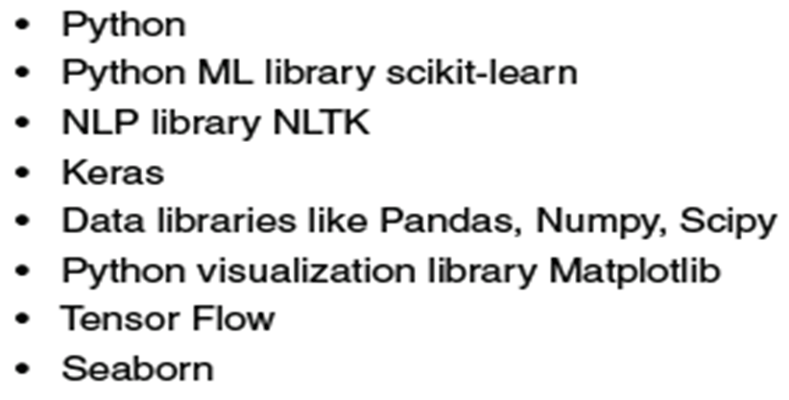
Languages & Machine Learning Programming

Slide 25
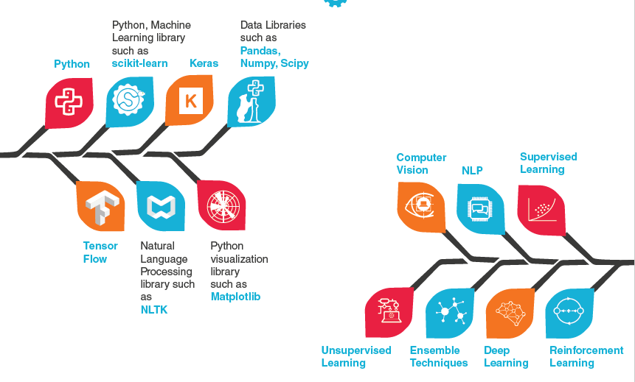
Machine learning Type/Packages

Slide 26
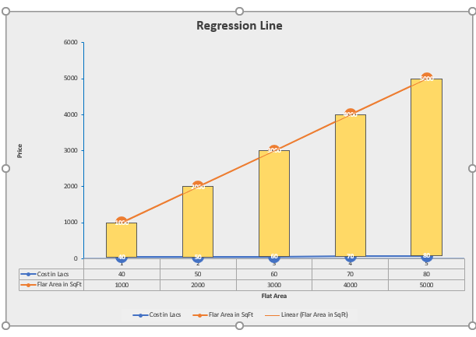
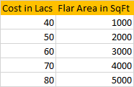
Linear Regression

Slide 27
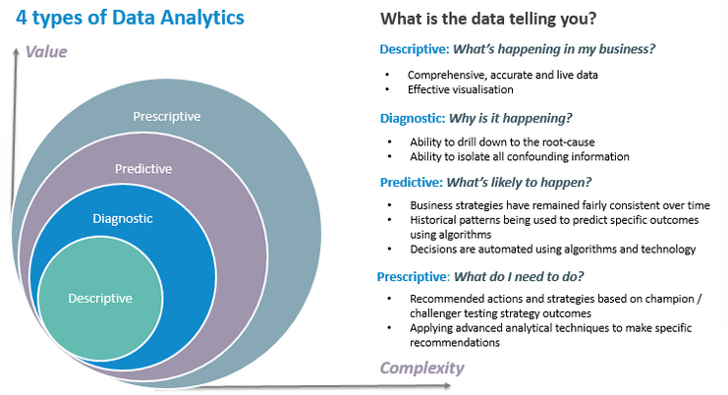
Analytics
Descriptive: descriptive analysis or statistics can summarize raw data and convert it into a form that can be easily understood by humans. They can describe in detail about an event that has occurred in the past. Works on Seen Data.
Diagnostic Analytics: The obvious successor to descriptive analytics is diagnostic analytics. Diagnostic analytical tools aid an analyst to dig deeper into an issue at hand so that they can arrive at the source of a problem.
Predictive: Any business that is pursuing success should have foresight. Predictive analytics helps businesses to forecast trends based on the current events. Works on unseen data
Prescriptive: This type of analytics explains the step-by-step process in a situation. For instance, a prescriptive analysis is what comes into play when your Uber driver gets the easier route from Gmaps. The best route was chosen by considering the distance of every available route from your pick-up route to the destination and the traffic constraints on each road.

Slide 28
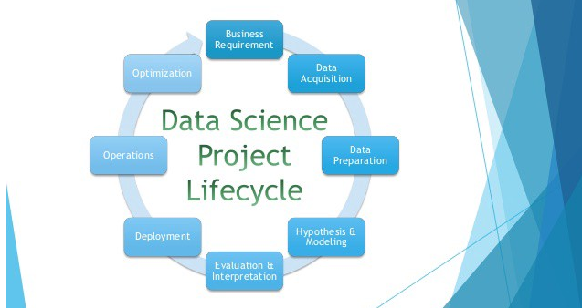
DS Life Cycle

Slide 29
Applications & Machine Learning Type
Will this customer churn-out from Idea to another vendor?
Supervised Learning - Classification
Customer Segmentation
Unsupervised Learning – Clustering
Will it rain tomorrow?
Supervised Learning – Classification
Driverless Car or Autonomous Car
Reinforcement Learning
Chess Game / Google Jumping guy
Reinforcement Learning
Finding Mileage of a vehicle
Supervised Learning – Linear Regression
Share price of a specific company
Supervised Learning – Multivariate Regression
Finding Bit coin price after 6 months
Supervised Learning – Regression (Multivariate)

Slide 30
Word of Caution!
Do not learn by learner but expert
Do not look at minimal fees
Unless you are good in programming and statistic/logical thinking or like to programming, then only jump into this field
Should have readiness to sit and solve problem until it is solved
No Hyderabad training – Course contents are too much as compare to actual learning
False marketing by training institutes
No programming required
No pre requisites

Slide 31
Q&A

